Slide 1
PRACTICAL DATABASE MANAGEMENT SYSTEM
K.P.NETHMI SANJANA
JL/22/ICT5/1/0033

Slide 2
CONTENT….
Introduction.
Objectives.
Scope of work.
Interfaces.

Slide 3
INTRODUCTION.
The project “Practical Database Management” is developed in java language. Which mainly focus on It will be possible to easily monitor of the practical activities related to a particular subject. Using this system, a user can get information about practical activities related to the subjects.

Slide 4
OBJECTIVE.
It provides “Better and efficient” service.
Reduce the workload of an institute.
Fast way to get information about the subject and practical activities.
All details will be available on a click for both student and instructor.

Slide 5
SCOPE OF WORK.
Practical Database Management System will organize work inside institute and proposed system will do the following tasks.
Add/ delete subjects’ information
Add/ delete/ update practical activities information
View practical activities related to the subject

Slide 6
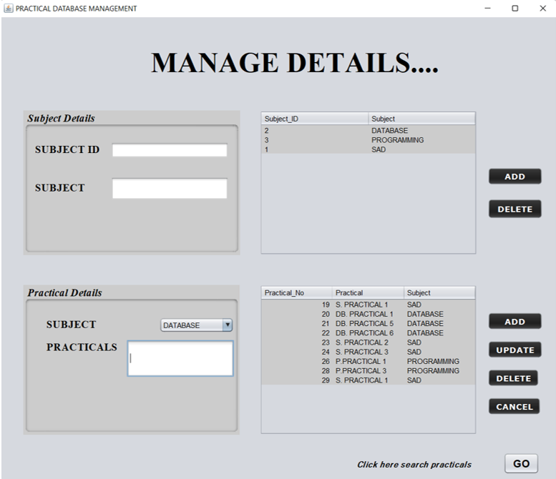
INTERFACES.
Here, subject can be added, removed and practical activities can be added, updated, deleted. Also the entered data is represented by a table.

Slide 7
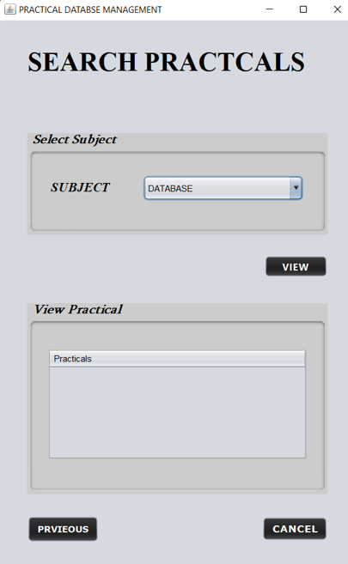
INTERFACES.
Here, select the relevant subject and see the practical activities related to that subject separately..

Slide 8
THANK YOU!

